Slide 1

P-153- Hourly Energy Consumption Forecast
TEAM 4
Mr. Dharmendra Vinod Makwana
Mr. Rajesh Mukund Bharati
Mr. Mohd Yasir
Ms. Sonali Sahu
Mr. Akshay Arvind Ukey
Mr. Tejas Ratti
Mr. Sonu Kumar
Mentor – Neha Gupta

Slide 2
BUSINESS OBJECTIVE
PJM Hourly Energy Consumption Data
PJM Interconnection LLC (PJM) is a regional transmission organization (RTO) in the United States. It is part of the Eastern Interconnection grid operating an electric transmission system serving all or parts of Delaware, Illinois, Indiana, Kentucky, Maryland, Michigan, New Jersey, North Carolina, Ohio, Pennsylvania, Tennessee, Virginia, West Virginia, and the District of Columbia.
The hourly power consumption data comes from PJM's website and are in megawatts (MW).
The regions have changed over the years so data may only appear for certain dates per region.
Throughout this project, we will be building a model to forecast monthly electricity consumption from PJM'S website. This model will be based on time series data.

Slide 3
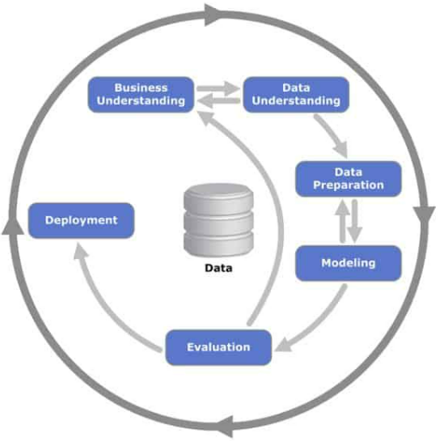
Project Architecture / Project Flow

Slide 4
EXPLORATORY DATA ANALYSIS
Insights of the dataset:
143206 rows & 1 columns.
4 duplicates values found.
30 Missing values.
No outliers detected
Data doesn’t look normal

Slide 5
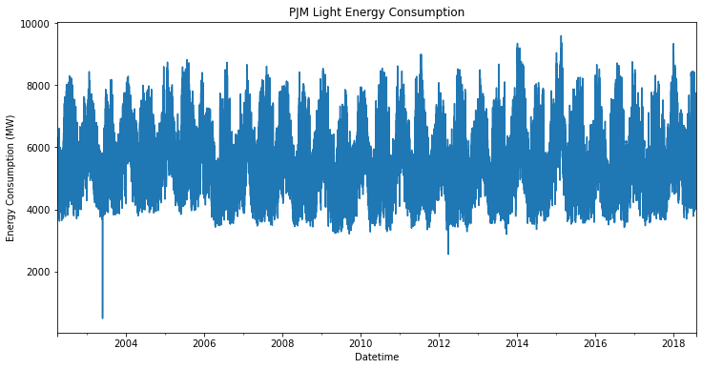
Data understanding
With this volume of data, we can’t see much with the exception of some possible fluctuation linked to seasonality throughout the year. Let’s take a look at annual average consumption.

Slide 6
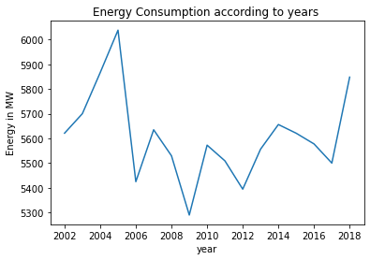
Data understanding
From the above figure we can see that high amount of energy consumed in the year 2002-2006 and 2018 compared to the other years.

Slide 7
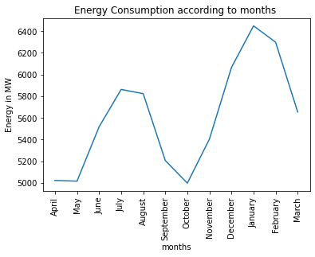
Data understanding
For summer and winter months typically have higher energy demand while spring and fall are lower. This matches intuition that months with more extreme temperatures have more energy consumption (likely due to increased use of air conditioners/fans and heaters).

Slide 8
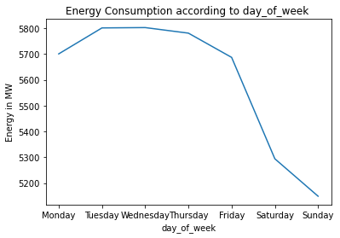
Data understanding
Energy consumption on Saturday and Sunday are lower. This reflects the intuition that energy use is typically lower on the weekends.

Slide 9
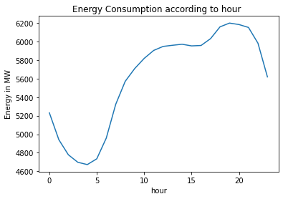
Data understanding
Here we can see the daily trend of energy consumption decreasing from 8pm to 5am. This reflects intuition that energy demand is lower at night when consumers are typically asleep. We also see an upward trend between 5am to 7pm. This reflects intuition that energy demand increases as consumers begin their day and evening.

Slide 10
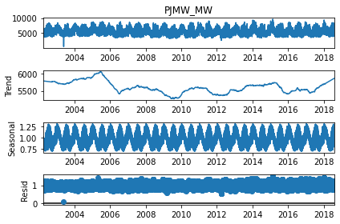
ETS Decomposition
We can see that, there is no trend. However, there is seasonality.

Slide 11
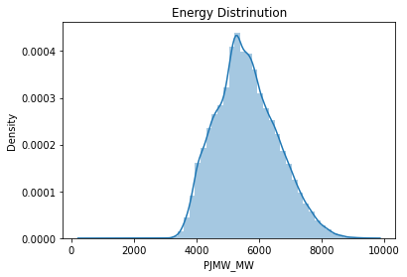
Energy Distribution
Due to constant trend, we see the normal distribution.

Slide 12
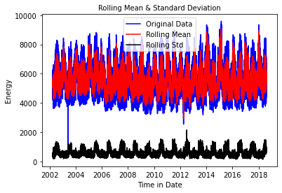
Stationarity Check
Test stationary using Augmented Dickey Fuller’s Test.
Stationary data is data whose statistical properties like mean, variance, covariance do not vary with time or these statistical properties are not the function of time. a stationary data series has without a Trend or Seasonal components.
Stationary series is easier for statistical models to predict effectively and precisely.
Test Statistic -19.935246
p-value 0.000000
#Lags Used 74.000000
Number of Observations Used 143157.000000
Critical Value (1%) -3.430396
Critical Value (5%) -2.861560
Critical Value (10%) -2.566781
dtype: float64
Failed to reject null hypothesis. Data is stationary
Here we got P-value as 0 because there is no trend in our data.

Slide 13
Resampling of data
Our data set have very large number of data points so we have down sampling our data for reducing the no. of data point.
By applying resample method the hourly data converted into daily data by which no. of data points decreases into 143232 to 5969.
Test Statistic -7.265243483352551,
p-value 1.6415165880027295e-10,
#Lags Used 33,
Number of Observations Used 5935,
{Critical Value '1%': -3.43145229664056,
Critical Value '5%': -2.8620271128107553,
Critical Value '10%': -2.56702928783387},
84235.17424544465)

Slide 14
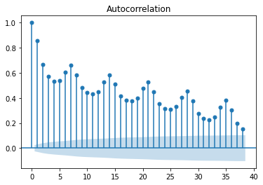
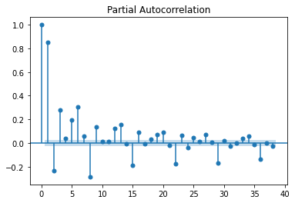
ACF and PACF for PJMW_MW
The above figure shows ACF and PACF relation for the resampled data without any differentiation.

Slide 15
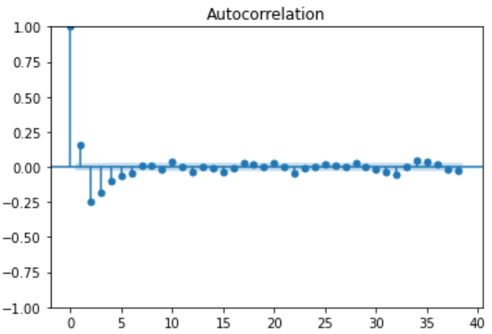
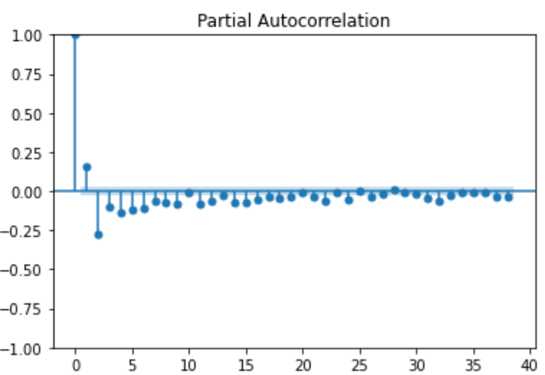
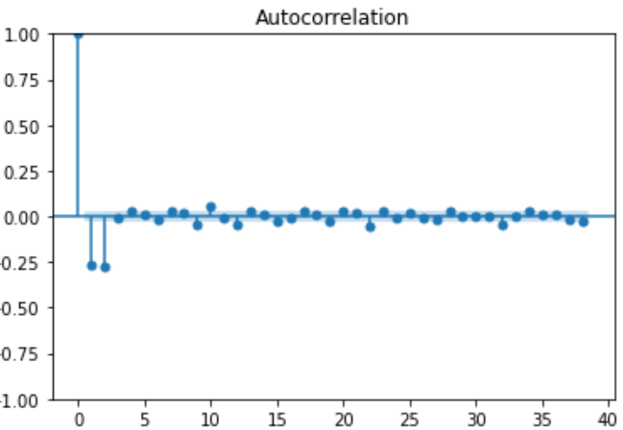
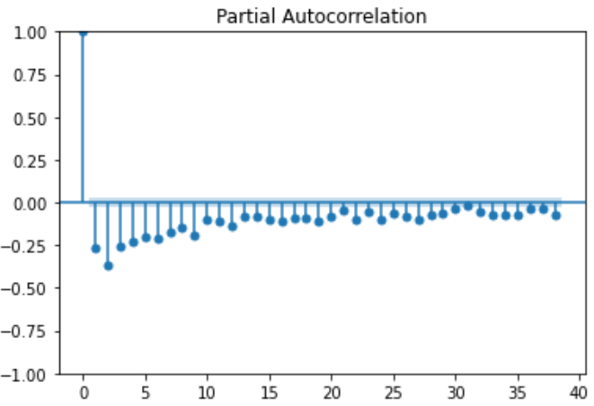

Slide 16
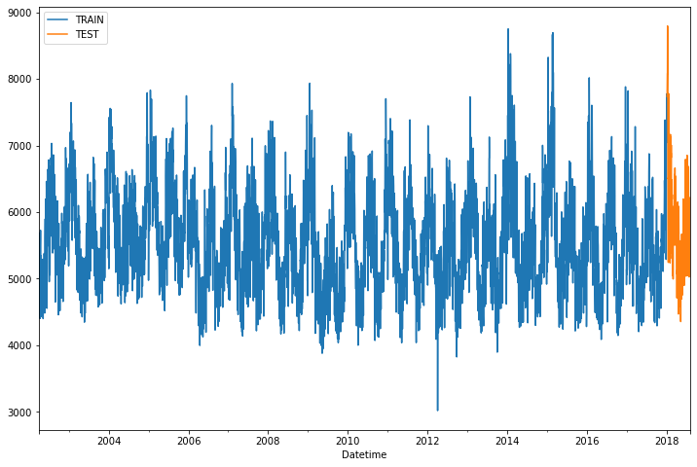
Splitting the data set into train and test
80% of our data set are taken for training and 20% of data taken for testing purpose
Train 5754 rows And 1 column
Test 215 rows and 1 column

Slide 17
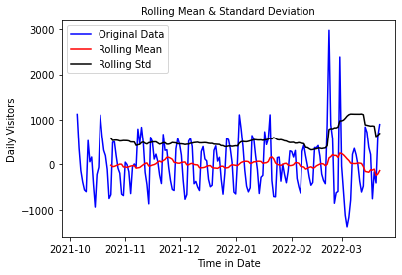
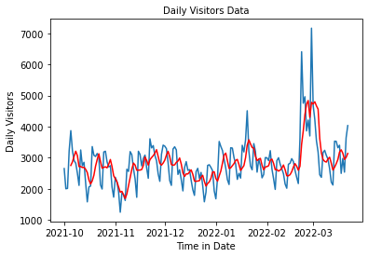
1. Moving Average
In this technique, we take average of ‘k’ consecutive values depending on the frequency of time series. Here, we will take the average over the past 5 Months.
The rolling mean values appear to be highly varying. The Test Statistic is smaller than the 10% 5%, and 1% of critical values. So, we can say with 99% confidence level that the dataset is a non stationary series.
Test Statistic -2.358587
p-value 0.153768
#Lags Used 14.000000
Number of Observations Used 158.000000
Critical Value (1%) -3.472431
Critical Value (5%) -2.880013
Critical Value (10%) -2.576619
dtype: float64
Failed to accept null hypothesis. Data is non-stationary

Slide 18
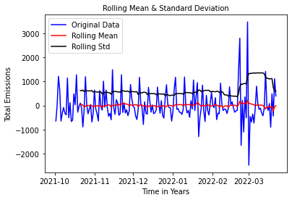
2. Eliminating Trend & seasonality : Differencing
Differencing : One of the most common methods of dealing with both trend and seasonality is differencing. In this technique, we take the difference of the observation at a particular instant with that at the previous instant. the dataset is a non stationary series.
1. First order difference:
Test Statistic -2.358587
p-value 0.153768
#Lags Used 14.000000
Number of Observations Used 158.000000
Critical Value (1%) -3.472431
Critical Value (5%) -2.880013
Critical Value (10%) -2.576619
dtype: float64
Failed to accept null hypothesis. Data is non-stationary
The first difference improves the stationarity of the series. Let us use also the seasonal difference to remove the seasonality of the data and see how that impacts stationarity of the data.

Slide 19
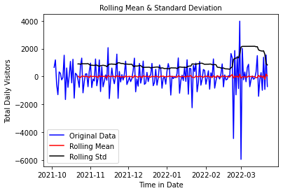
2. Seasonal first order difference:
Now, if we look the Test Statistic and the p-value, taking the seasonal first order difference has made our the time series dataset stationary. We are considering this seasonal first difference for further analysis because it looks more stationary
Test Statistic -6.432838e+00
p-value 1.680769e-08
#Lags Used 1.300000e+01
Number of Observations Used 1.570000e+02
Critical Value (1%) -3.472703e+00
Critical Value (5%) -2.880132e+00
Critical Value (10%) -2.576683e+00
dtype: float64
Failed to reject null hypothesis. Data is stationary

Slide 20
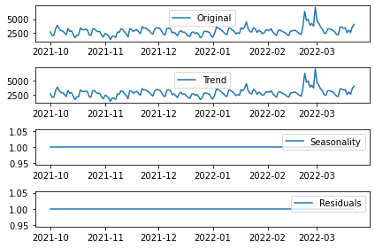
3. Eliminating Trend & seasonality : Decomposing
In this approach, both trend and seasonality are modeled separately and the remaining part of the series is returned.
Here we can see that the trend, seasonality are separated out from data and we can model the trend. Let's check stationarity of trend:

Slide 21
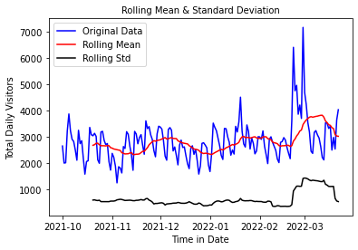
Data remains Non-stationary
Data remains Non-stationary
Test Statistic -2.358587
p-value 0.153768
#Lags Used 14.000000
Number of Observations Used 158.000000
Critical Value (1%) -3.472431 Critical Value (5%) -2.880013 Critical Value (10%) -2.576619 dtype: float64
Failed to accept null hypothesis. Data is non-stationary

Slide 22
MODEL BUILDING

Slide 23
Model Building
Model building done both on Stationary and non-stationary data set
Models used:
ARIMA(Auto Regressive Integrated Moving Average)
AR(Auto Regressive)
MA(Moving Average)
Auto ARIMA
Simple Exponential smoothing
Double Exponential smoothing or Holt’s method
Triple Exponential smoothing or Holt’s –Winter method
Last Sample Technique Method (LSTM) using RNN

Slide 24
Model Building on Stationary data
Now building model on stationary after transforming the original data to stationary data.

Slide 25
Plot the ACF and PACF charts
Autocorrelation Function (ACF): It is a measure of the correlation between the time series with a lagged version of itself.
Partial Autocorrelation Function (PACF): This measures the correlation between the time series with a lagged version of itself but after eliminating the variations already explained by the intervening comparisons.
In the next step we will be determining the tuning parameters (p and q) of the model by looking at the autocorrelation and partial autocorrelation plots. The plot below provides a brief guide on how to read the autocorrelation and partial autocorrelation graphs in order to select the parameters.

Slide 26
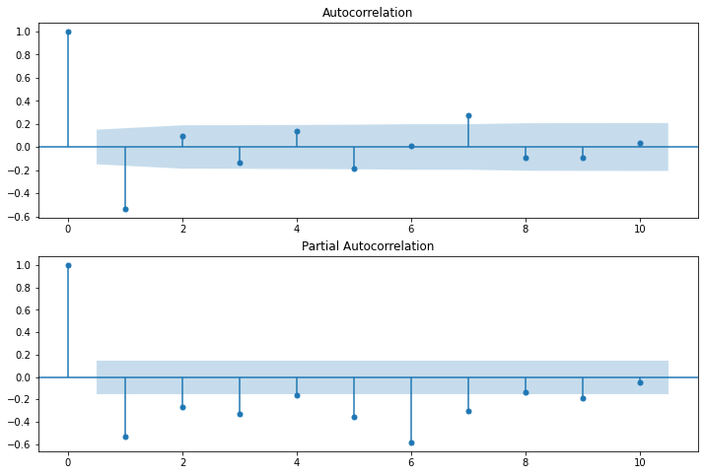
p – The lag value where the PACF chart crosses the upper confidence interval for the first time. If you notice closely, in this case p=2.
q – The lag value where the ACF chart crosses the upper confidence interval for the first time. If you notice closely, in this case q=2.

Slide 27
DATA PARTITIONING
Using Seasonal first order difference for building model for stationary data because it shows more stationarity.
Training Data = Fit the model only to training period
Validating Data = Assess the model performance on validation
Deploy model by training on whole dataset
No random partition That’s because the order sequence of the time series should be intact in order to use it for forecasting.

Slide 28
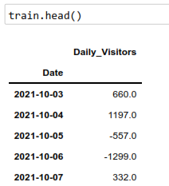
Hyper-parameter Tuning using Grid Search
Done Grid search for hyper-parameters to find out optimal order or (p, d ,q) for ARIMA model.
Best oder found is (0,1,2) with least RMSE.

Slide 29
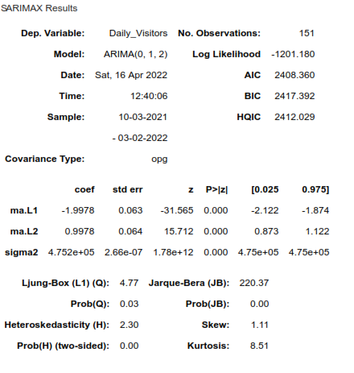
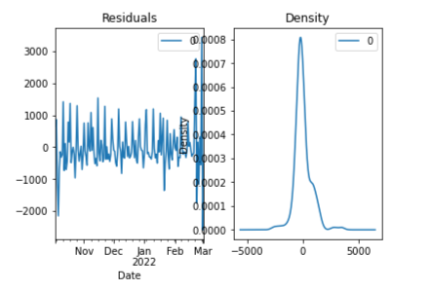
1. Model on Stationary Data
1. Auto Regressive Integrated Moving Average (ARIMA)

Slide 30
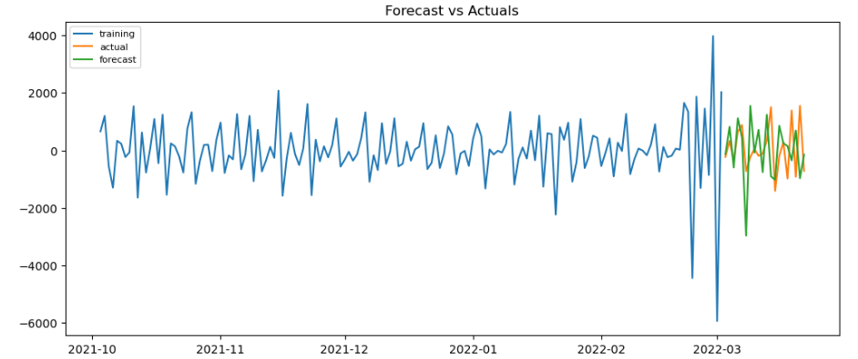


Slide 31
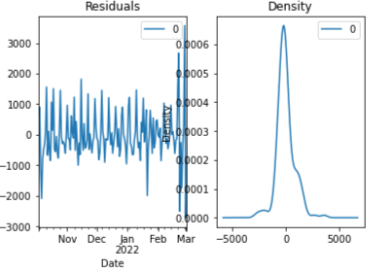
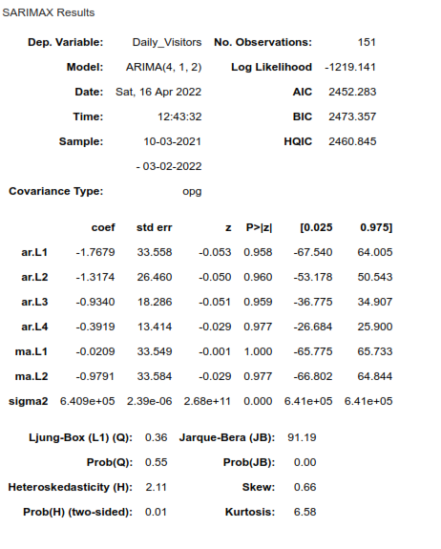
Moving Average (MA) Model

Slide 32
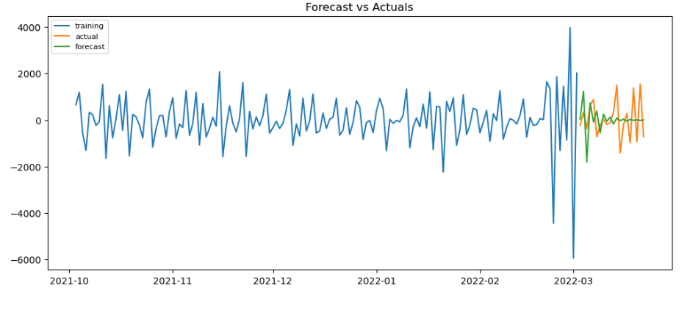


Slide 33
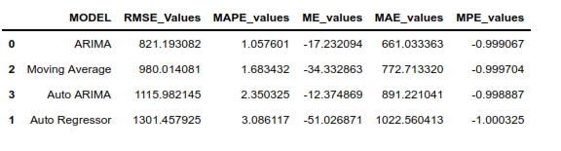
Comparing models build on stationary data
ARIMA gave least RMSE

Slide 34
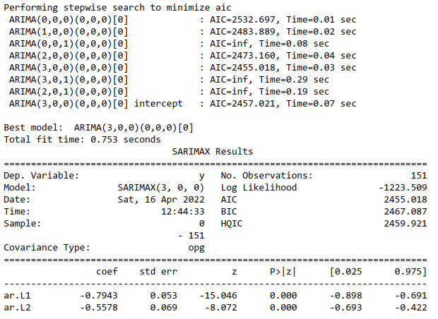
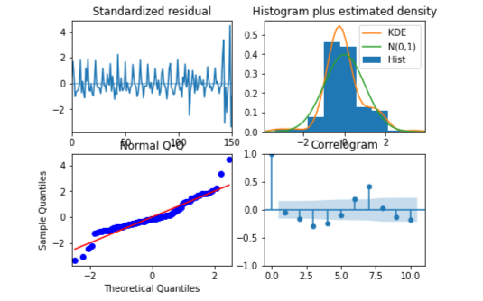
Auto ARIMA Model

Slide 35
splitting the data into training and testing
MSE random forest Error: 236917.22826086957
RMSE random forest Error: 486.7414388162051
MAPE random forest: 6.47

Slide 36
Building Random forest model
MSE random forest Error: 236917.22826086957
RMSE random forest Error: 486.7414388162051
MAPE random forest: 6.47

Slide 37
Linear Regression Model
MSE linear regression : 123245.29422721769
RMSE linear regression : 351.06309151948415
MAPE linear regression: 4.726

Slide 38
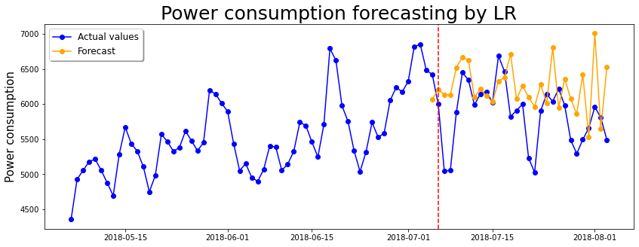
calculating forecasting accuracy
Linear Regression Model
Date range '2018-07-05','2018-08-03'

Slide 39
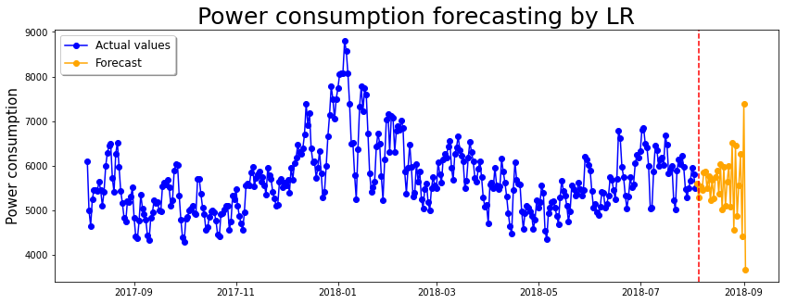
Forecast for future using linear regression model
Date range '2018-08-04','2018-09-02

